Slide 1
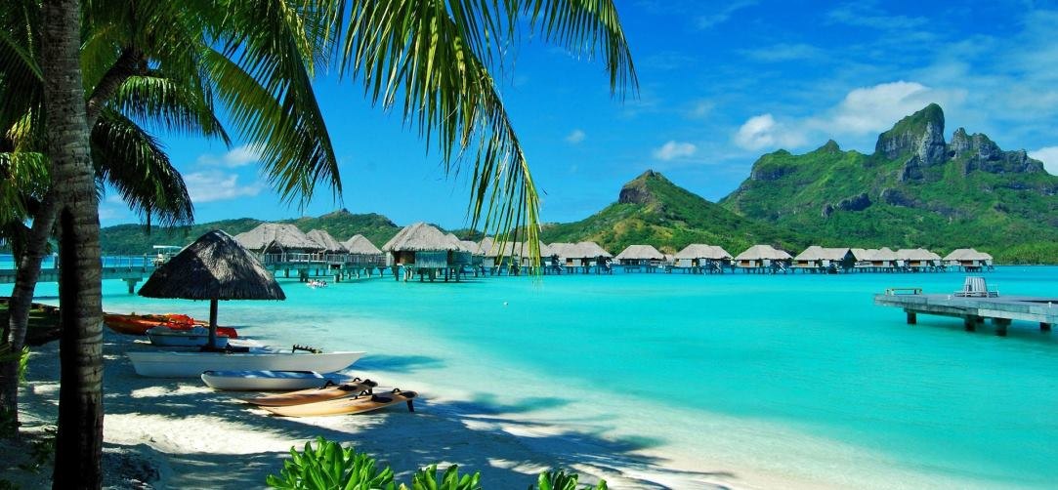
Hawaii
Denise Mora Jimmy Sachaal
Rosa Parra Angelica Reyes
Erica Sears Mitzi Izquierdo
Aidreana Quiles Sean Oberbeck

Slide 2
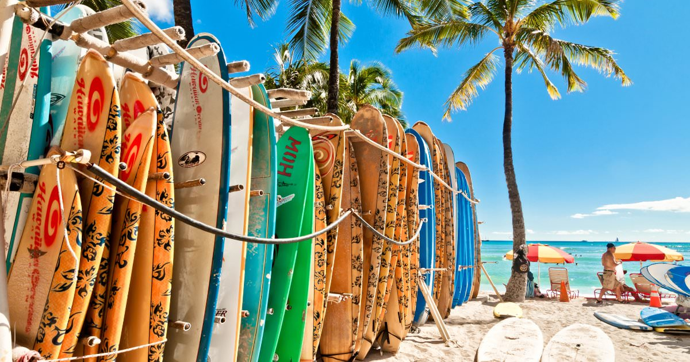
Question
How can tourism be maintained at a sustainable cost to the environment?

Slide 3
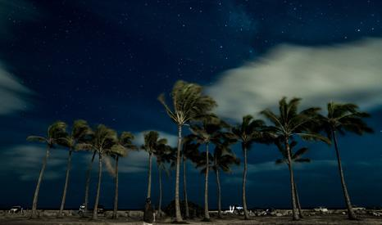
Agenda
Physical geography- Angelica Reyes
Climate -Rosa parra Monroy
historical geography and settlement- Erica
cultural perspectives - Mitzi Izquierdo
regional life-Aidreana Quiles
Economy- Jimmy
2 sections from our text: unintended consequences (pg. 961), Sustainable future in Hawaii-Sean
Journal article: Sunscreen and The Coral Reef

Slide 4
Physical geography
In
Hawaii

Slide 5
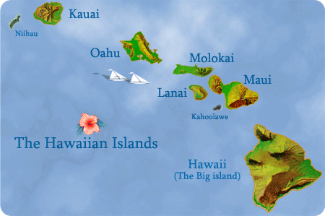
Hawaiian Islands
Hawaii (4,028 square miles)
Maui (727 square miles)
Oahu (597 square miles)
Kauai (552 square miles)
Molokai (260 square miles)
Lānai (141 square miles)
Niihau (72 square miles)
Kahoolawe (45 square miles)

Slide 6
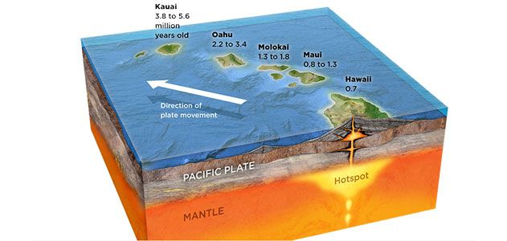
HOw were they formed?

Slide 7
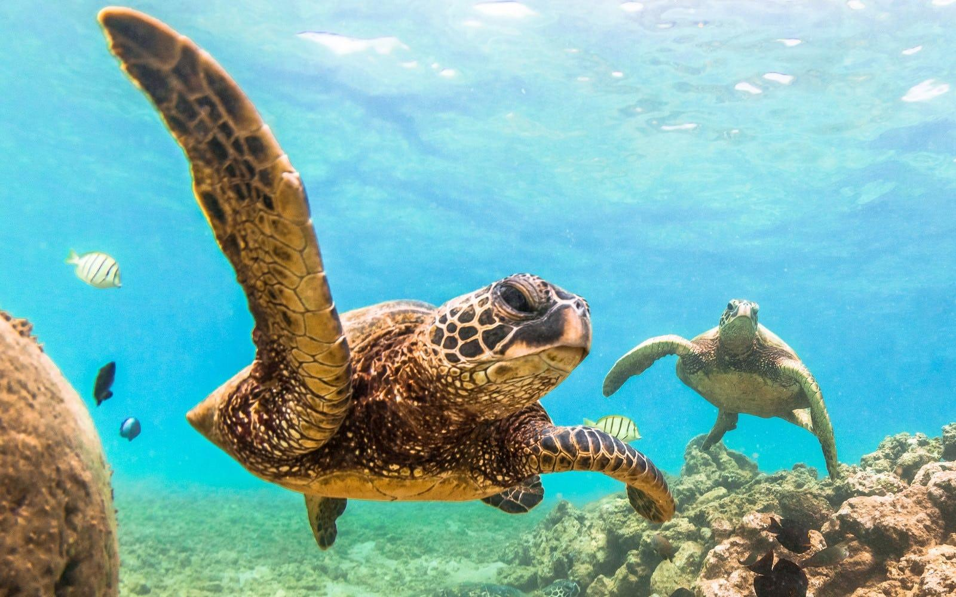
The Northwestern Islands
The Northwest Islands are the oldest.
During the past fifty years, the Northwestern Island waters have lost species to overfishing and erosion.
To prevent further ecosystem losses, in June 2006 the Northwestern Islands were declared a national monument and became the world’s largest marine reserve.

Slide 8
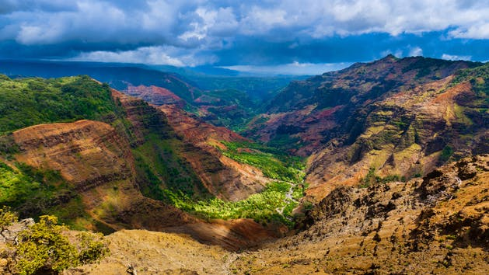
Kauai
Niihau
The oldest inhabited island, Kaua’i, has been volcanically inactive in recorded history and has developed lush vegetation.
Its main attraction is the Waimea Canyon
“The Grand Canyon of the Pacific”
Known as the Forbidden isle
The Sinclair-Robinson family purchased the from Kamehameha V in 1864
Preserving the Hawaiian language and culture by rejecting technology.
They recieve 12 inches a rain annually which leads to some evacuating to Kauai.

Slide 9
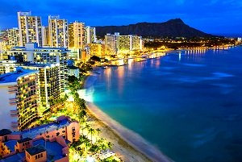
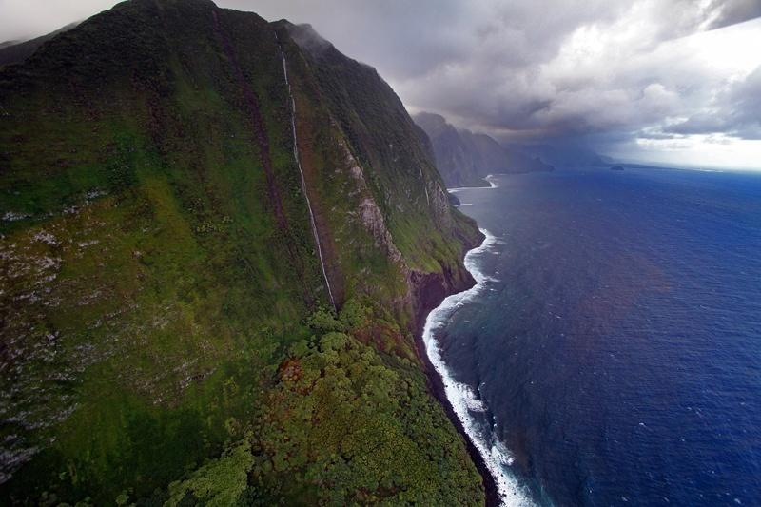
Oahu
Molokai
Was formed by volcanoes Waianae and Koolau.
80% of the state population resides in Oahu.
Honolulu, the capital of Hawaii, is located in Oahu
Water issues and Desal water
Known as the “friendly isle”
Native Hawaiians constitute the majority of the population and has few tourist.
Has the Highest pali (cliffs) in the world.
3 thousand feet.

Slide 10
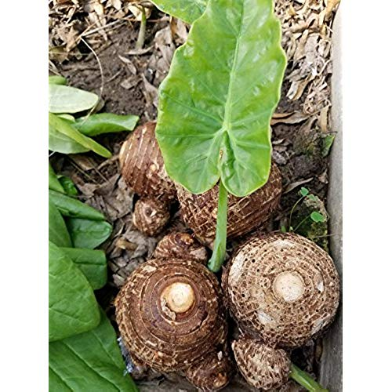
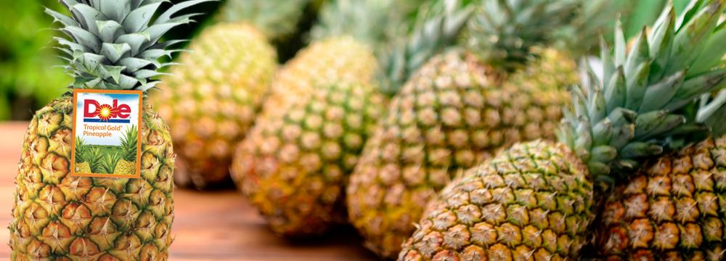
Maui
Lanai
At one time, the four islands Lānai, Kahoolawe, Molokai, and Maui were one island called Maui Nui.
It is seperated from east and west by a narrow isthmus.
It faces water shortages because of urban population and competing agriculture.
Conflict between small traditional taro farmers with sugar and pineapple corporation.
Since 1917, the Dole pineapple plantation has run the island.
Castle and Cooke purchased 98% of the island.
Tried to turn into a tourist resort but failed
David Murdock Purchased the Castle and cooke in 1985
Built two luxury resorts
It is for the uber-wealthy

Slide 11
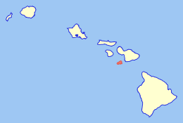
Kahoolawe
Hawaii
Smallest island
Was used as a penal colony (1826-1853)
Also used as bombing practice
In 1981 it was register as historic place
Today Natives protect the environmental restoration and manage the land.
The youngest and largest island
Has the most climatic regions
Has 5 volcanoes
Kohala
Mauna Kea
Hualalai
Mauna Loa
Kilauea
Kilauea is the most active volcano that it adds on additional 42 acres annually

Slide 12
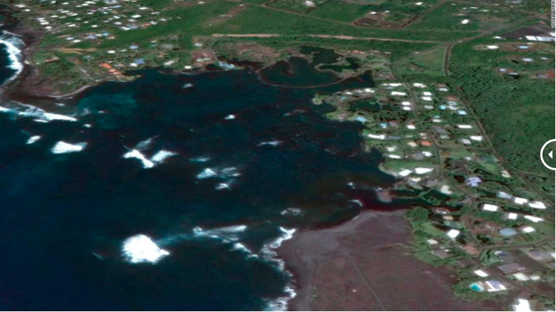
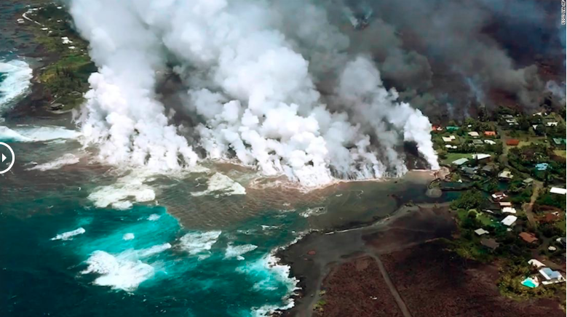
Kilauea volcano
2016 shows Kapoho Bay on the island of Hawaii before the Kilauea volcano erupted
An image taken on June 4, 2018 with lava spilling into the bay.
Notes:
https://www.cnn.com/2018/07/17/us/hawaii-kilauea-volcano-overview/index.html
https://volcanoes.usgs.gov/observatories/hvo/hvo_volcano_watch.html

Slide 13
Climate

Slide 14
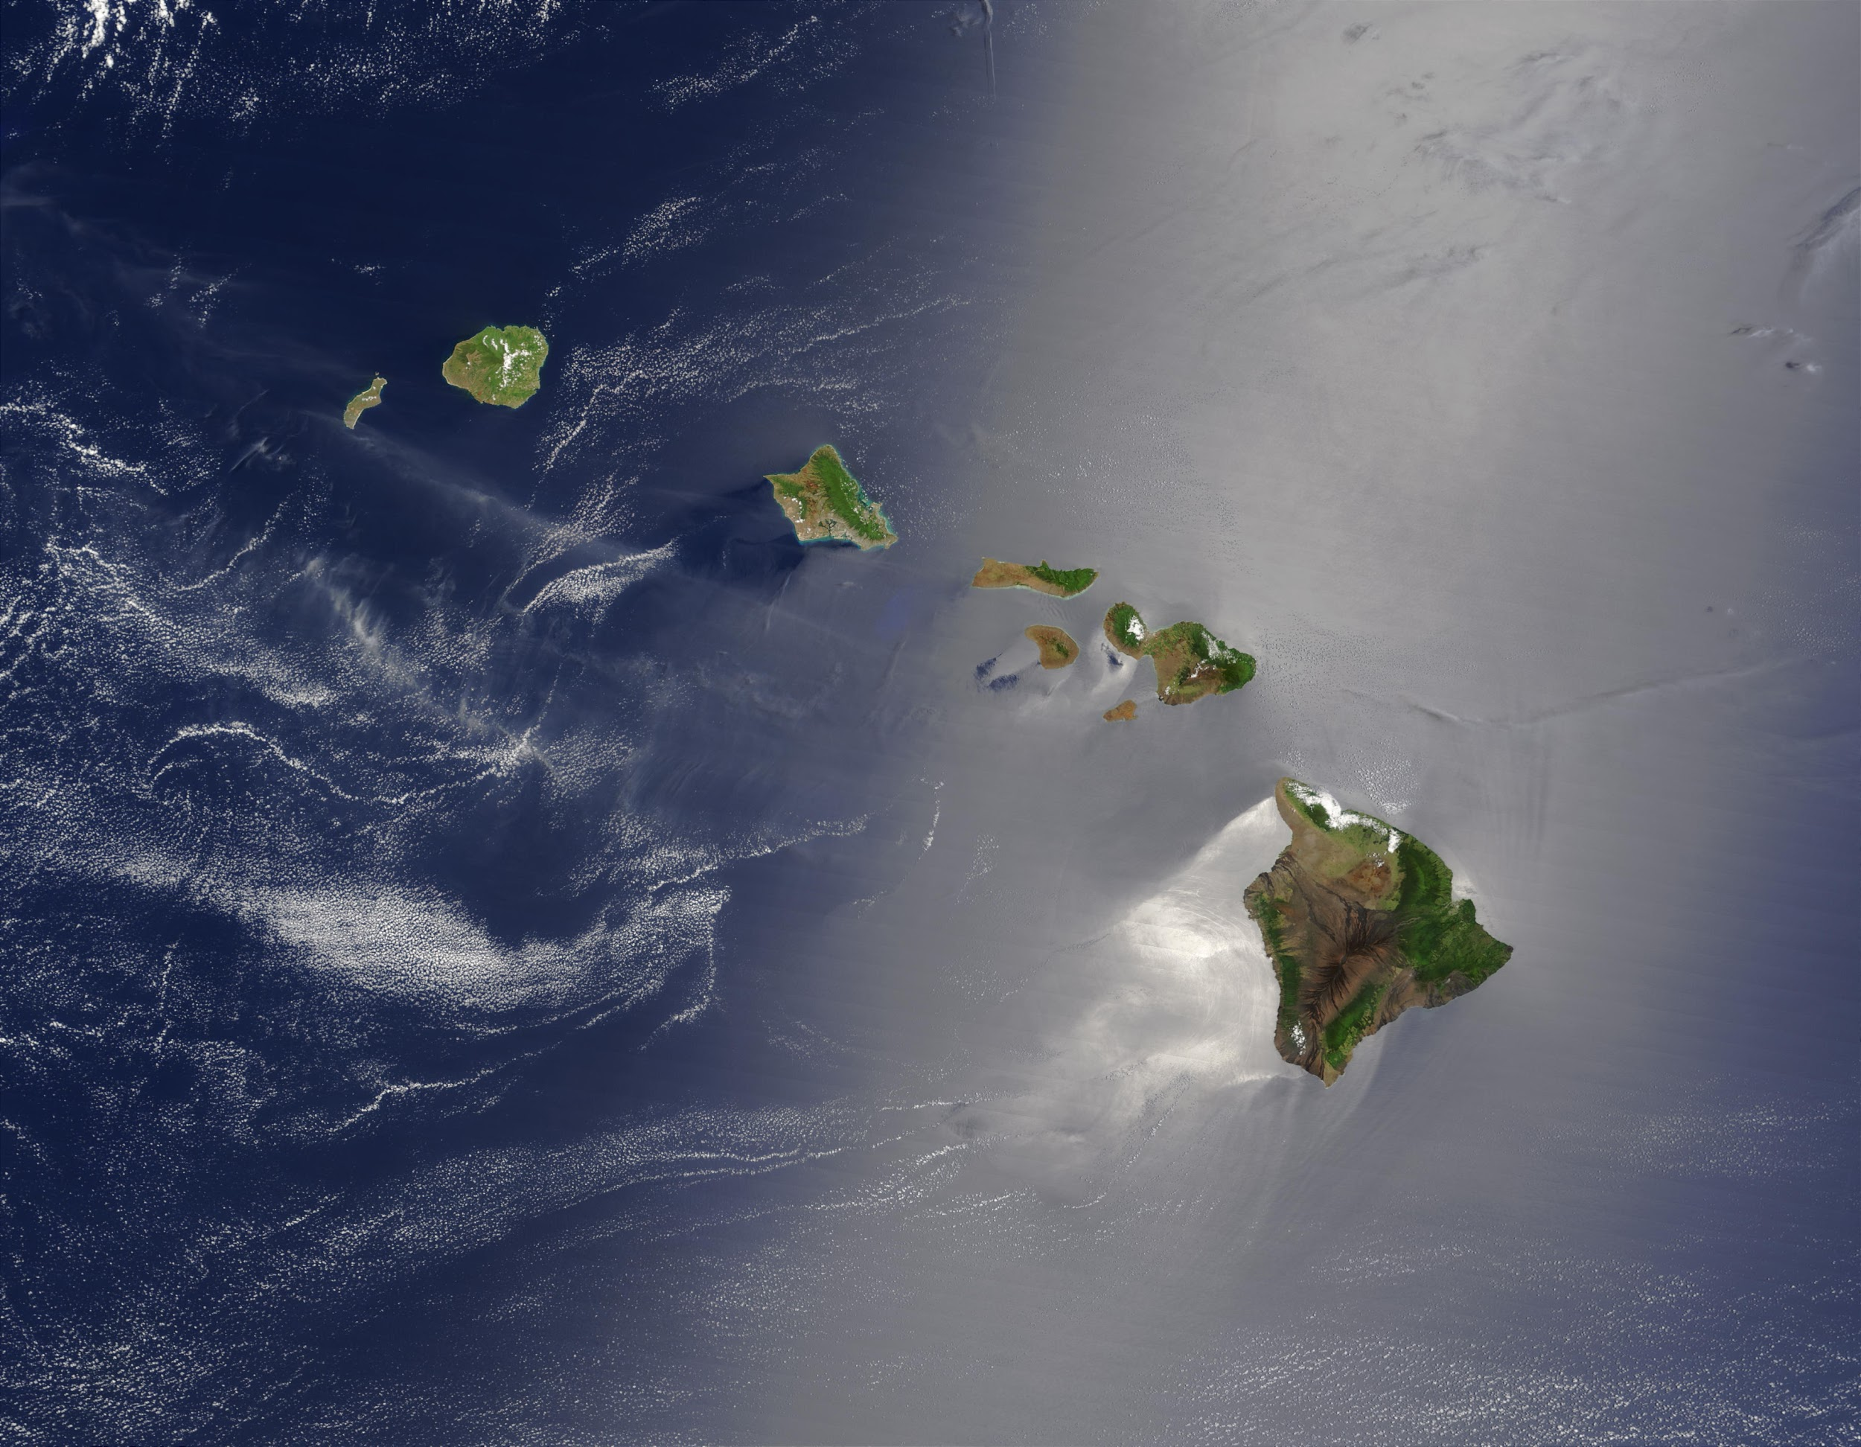
Tropical Climate of hawaii
The climate is affected by trade winds giving a cooling effect
There are only two seasons
Summer is from May to October
Winter is from November to April
The warm air temperatures range from 85°F in the Summer to 78°F in the Winter
In the higher elevations on top of Volcanoes temperatures average 40°F

Slide 15
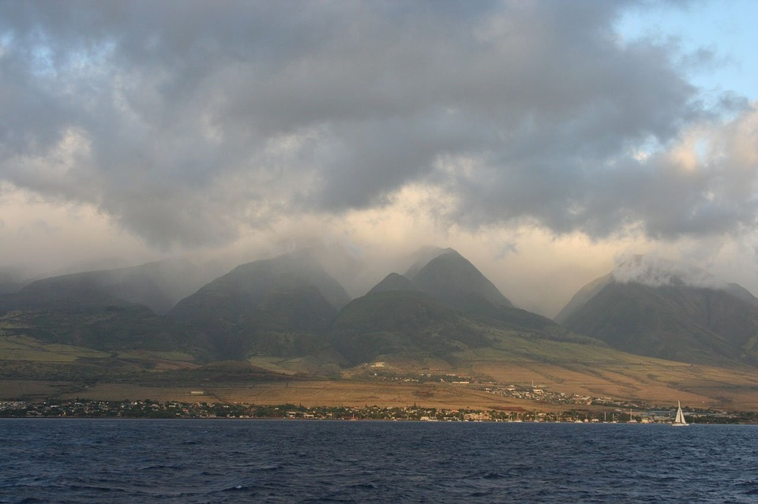
Rainfall
average rainfall that is 25% annually.
October to March are considered the Rain season
Since there is distinct rainfall patterns it determines the location of the main tourism economy

Slide 16
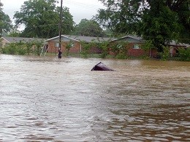
Flooding In Kauai
In April 2017, Kauai had record rainfall.
28 plus inches of rain in about 24 hours.
As a result, there were mudslides
Over 500 people were airlifted or transported by bus or boat

Slide 17
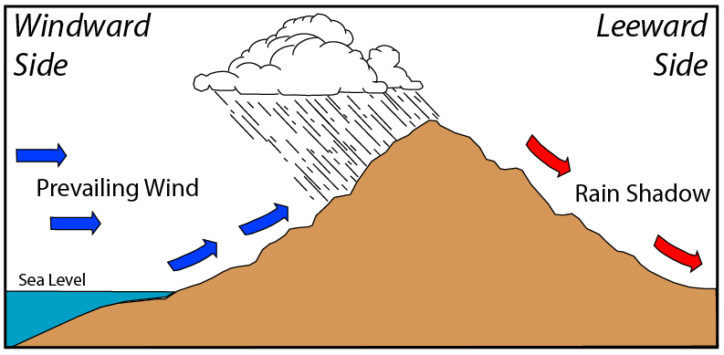
Windward vs. Leeward
Windward
on the northeast side of the islands
receives lots of rainfall
Leeward
on the southwest side of the islands
It is protected from rainfall and wind

Slide 18
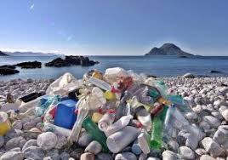
Waste disposal and garbage
Closed Ecosystem
Waste remains on the Island or dumped into water
The largest garbage collection area is in the warm and cold water convergence zone Northwest of the Hawaiian Islands
Trash turns up on the beaches of Hawaii from many areas of surrounding water

Slide 19
The Historical Geography and Settlement of the Hawaiian Islands
Notes:
These are all the sources i used for my section.
The textbook: Mayda, Chris. The Regional Geography of The United States and Canada .Plymouth, UK: Rowman & Littlefield Publishers , 2013.
Website: Hawaii’s History https://www.travelonline.com/hawaii/history
Hawaiian History Britannica https://www.britannica.com/place/Hawaii-state
Countries and their Cultures https://www.everyculture.com/multi/Ha-La/Hawaiians.html

Slide 20
The First Initial
The Polynesians
The Tahitians
Hawaii was one of the last places to be settled
During 400 CE Polynesians from Marquesas migrated on canoes
Traveled more than 3200 km, guided only by the stars.
Researchers believe that El Nino cycle could have aided the seafarers.
El Nino is a weather phenomenon that changes wind pattern and warms the ocean water.
Tahitians migrated to the Islands between 900-1000 CE
The Tahitian settlers brought with them some of their customs
Feudal System, or Chiefdom
Kapu Code of Conduct
Human Sacrifice
Temple building
Caste System
Tahitian customs birthed Hawaiian culture, including surfing and the Hula.

Slide 21
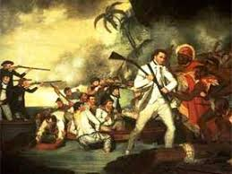
European ARRIVAL
Surprisingly, Spain somehow missed Hawaii
Had trading posts set up between Mexico and Manilla, to better trade with China.
Captain Cook was the first European to stumble across the Islands
Europeans completely altered the native land and Native population.
Sailors brought diseases, including smallpox and measles
Led to a significant decrease in the Native population.
They also brought weapons, which made conflicts between chiefs more deadly.
They also brought over European political structures, including Monarchy.
it was bound to happen...

Slide 22
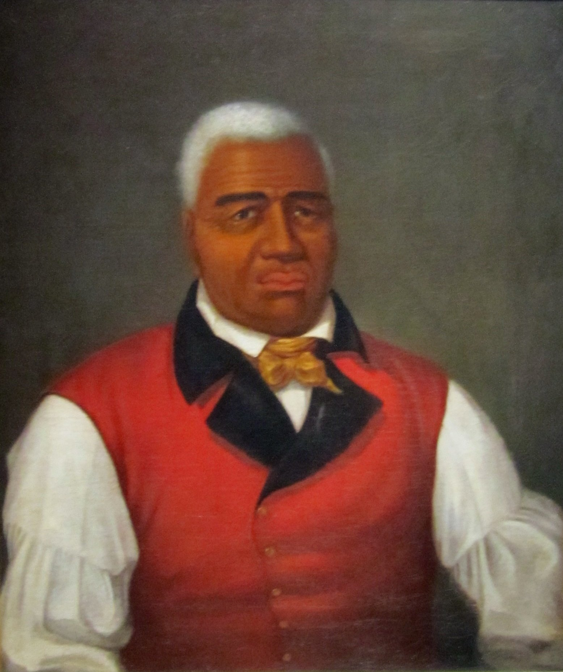
King Kamehameha I
King Kamehameha was the first chief to unify all the Hawaiian Islands and Chiefdoms
He was successful with the help of European weapons.
In 1820, missionaries began arriving in Hawaii attempting to convert the Natives.
King K established Hawaii as a Christian Monarchy
There was an initial clash of cultures
Slowly the Natives began to accept and practice Christianity
European migration still continued , so did western practices.
Including western idea of land ownership.
This led to a loss in Native land rights, prior to Europeans the land could be used by all.
Hawaii’s Unification

Slide 23
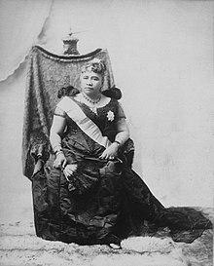
Queen Liliuokalani
Queen Liliuokalani ruled Hawaii under a constitutional monarchy.
During her rule, foreigners began making a profit from Hawaiian crops.
Sugar
Pineapple - Dole
American colonists were in search of controlling the Island's economy.
Queen L sought to restore Hawaiian nationalism and Native Hawaiian sovereignty
Planters who felt threatened, staged a peaceful coup.
They deposed her and formed the Republic of Hawaii.
WThe US also opposed this coup at the time.
The last Hawaiian Monarch

Slide 24
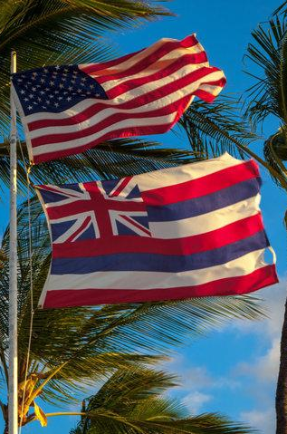
U.S. Annexation
In 1898 the US annexed the Hawaiian Islands as a political strategy.
They claimed 1.8M acres for US military use, i.e Pearl Harbor
Hawaii was annexed despite Native Hawaiian opposition.
In 1900 they claimed the Islands as a territory.
Native Hawaiians believe that the coup illegally expropriated the land and denied them of land rights.
Native Hawaiians are still fighting to get National recognition.
Comparable to the status of Native Americans.
Hawaiian state and national government representatives support Hawaiian sovereignty.
In 1959 Hawaii officially became the 50th State.

Slide 25
Cultural perspectives in hawaii

Slide 26
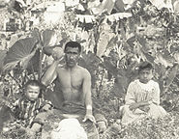
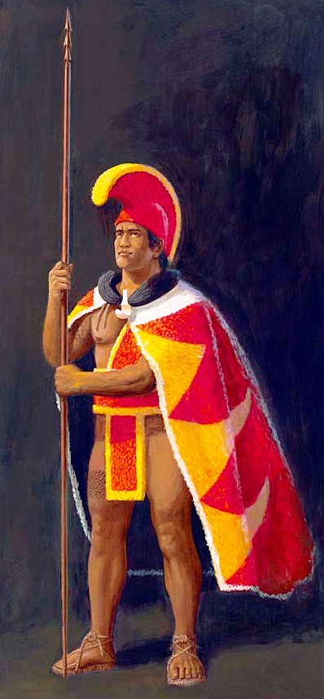
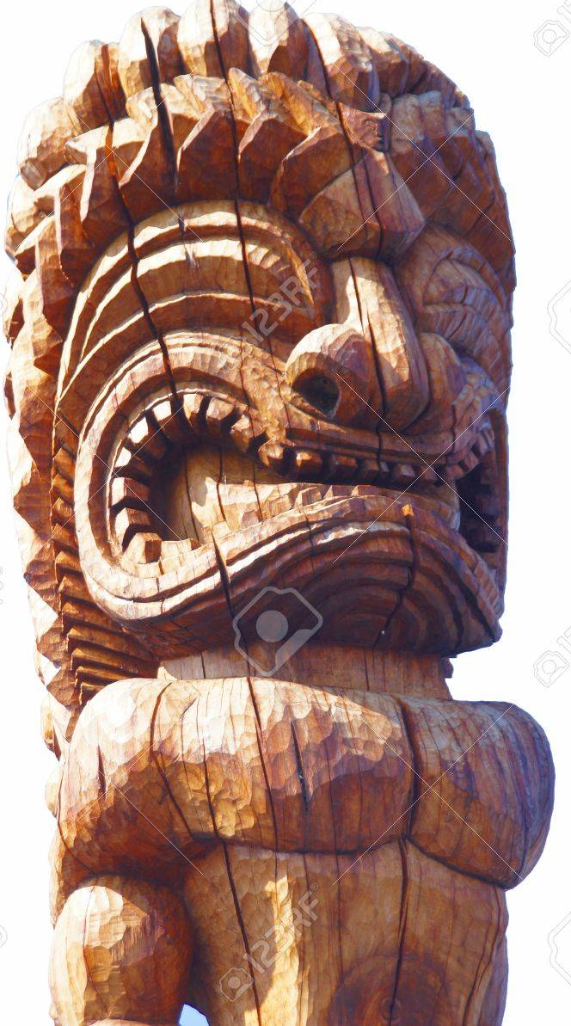


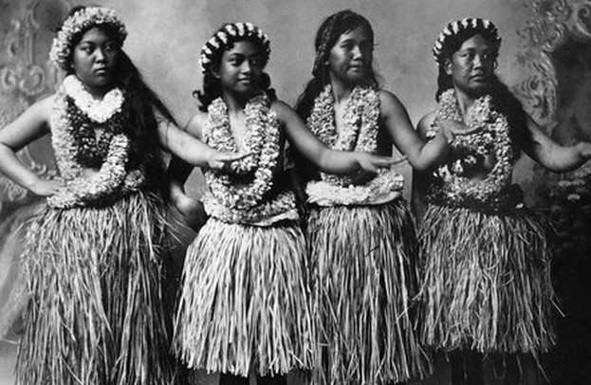
Kapu system
SEPARATE
CAUSED: Spatial segregation

Slide 27
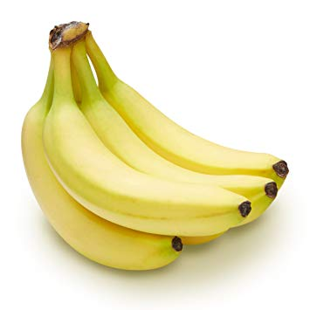
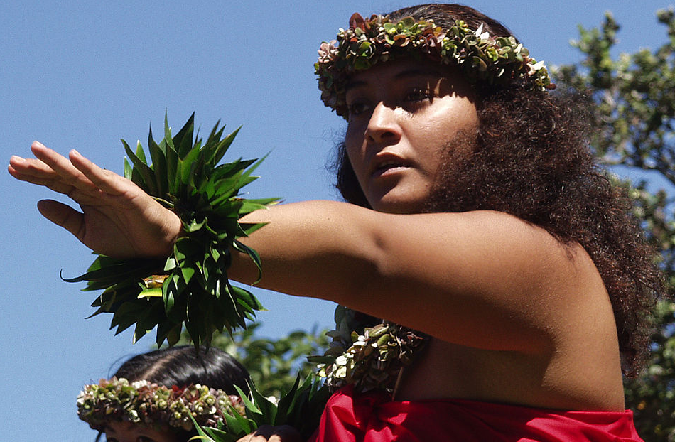
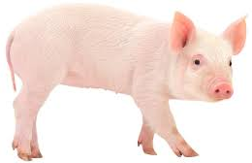
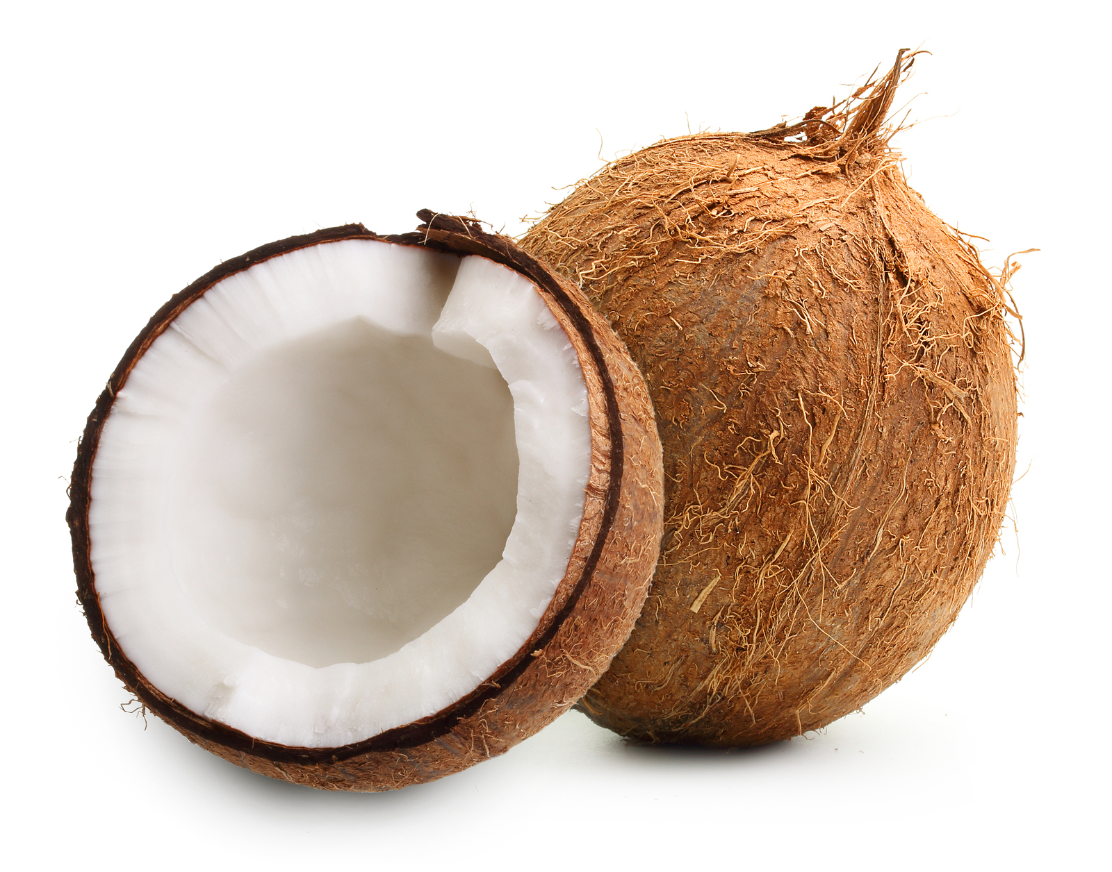
Kapu practices
Punishable by DEATH
Proper Etiquette Around Chiefs
Forbidden Food.... FOR WOMEN
NO EYE CONTACT
DO NOT WEAR ROYAL COLORS
KEEP HEAD LOWER

Slide 28
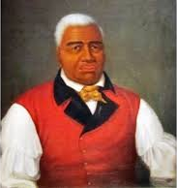

END OF KAPU
Foreigners did not practice KAPU and did not suffer its consequences...
Opens Door for Christianity
Leads to King to CEREMONIOUSLY break the tradition ending KAPU 1819.

Slide 29
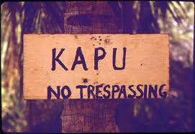
Kapu today
Kapu encompassed tradition in a form of laws and regulations
Today it is used as a “No Trespassing” sign
End of traditional Hawaii

Slide 30
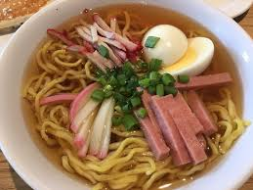
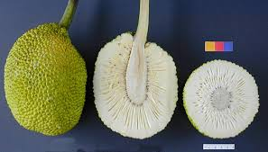
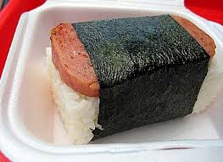
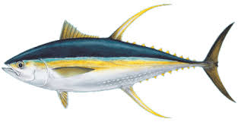
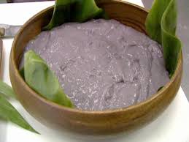
Hawaiian Diet
STAPLE FOODS
Fish and Starches
Traditionally: Seafood and Local Foods (bananas, taro, breadfruit, yams)
Now: Fatty/Processed foods high in sugar and flour
Birth of Hawaiian Fast Food:
Saimin and Spam

Slide 31
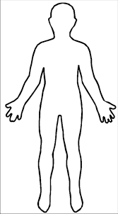
Causes
COMPLICATIONS
Obesity
Shorter Lifespans
Overall Health
New Diet
Sedentary Lifestyle
Genetic Capability
to store fat

Slide 32
Regional life
In
Hawaii

Slide 33
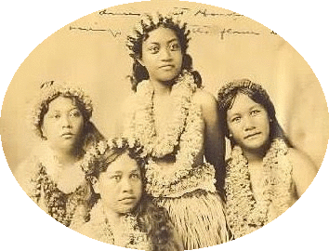
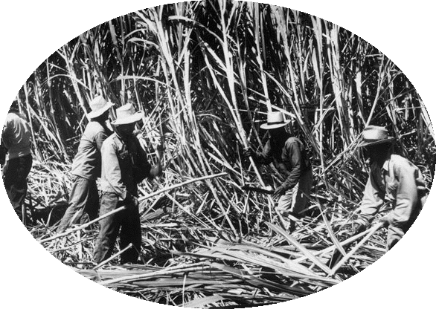
Population
In 1960 the Hawaiian population was 633,000
By 2010 the population more than doubled to 1,380,301
During the sugarcane Era there was a need for laborers, which brought different cultures to Hawaii creating a more diverse population
Today there are approximately 80,000 pure Hawaiians, but 250,000 claim Hawaiian blood

Slide 34
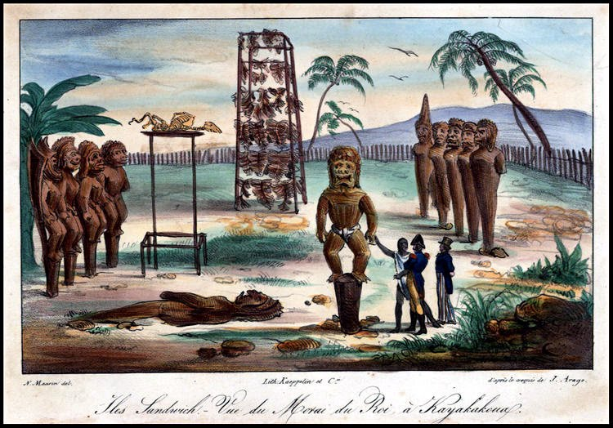
Language, & religion,
Language
The Hawaiian language (Olelo Hawaii) is one of the oldest living languages in the world
In 1898 the Hawaiian language was banned to be spoken but still was used in written word
Third language of Hawaii is Pidgin, which originates from the plantation workers, who came to Hawaii in the 19th century
Religion
Prior to the 1820’s many Hawaiians were pagans until the Christian missionaries came
Today the religion in Hawaii is very diverse

Slide 35
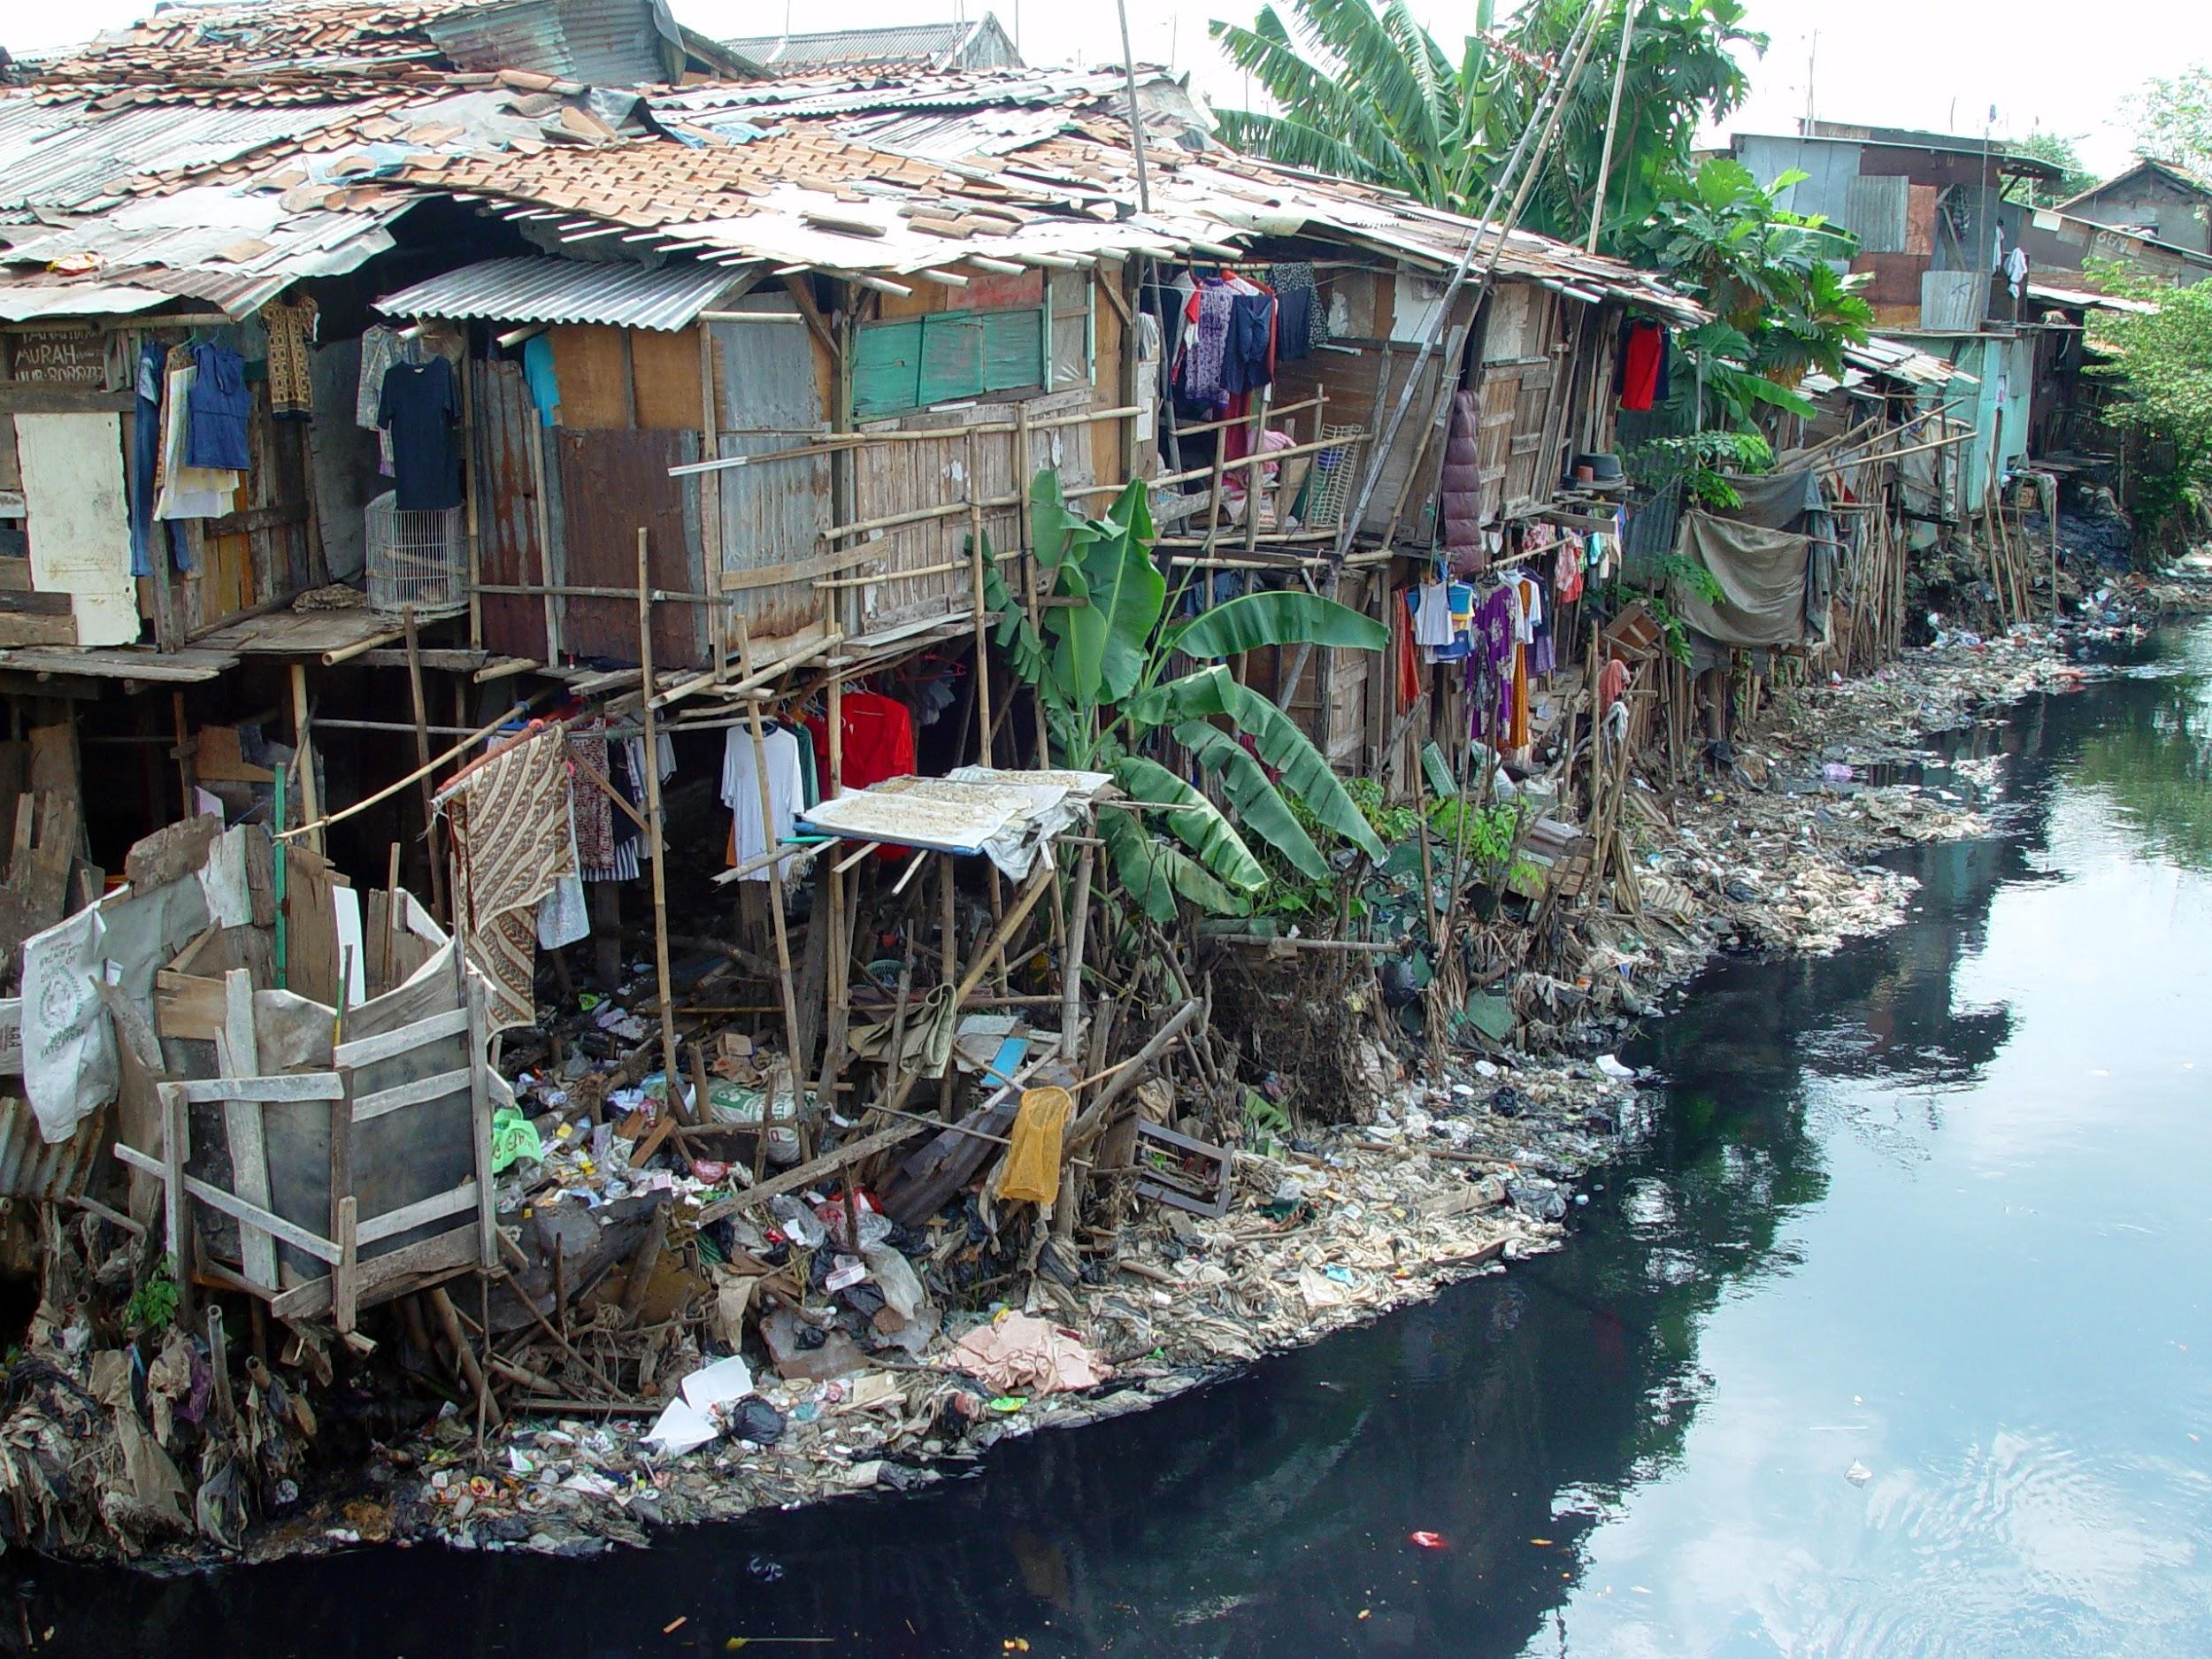
Poverty
Those who identify as Hawaiian are among the poorest, have the worst health statistics (mortality, suicide, disease), high dropout rate, highest unemployment rate, and highest incarceration rate.
Many are homeless and their land has been taken over by the government but they continue to “squat” on this land.

Slide 36
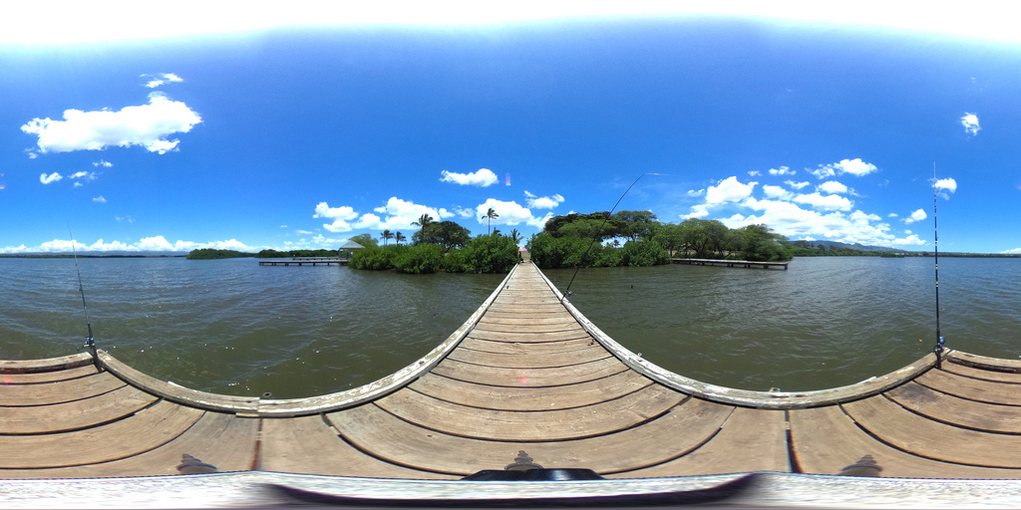
Land Ownership
Since the arrival of Europeans, native Hawaiians have lost control of their homelands, but till this day they are not recognized for any sovereignty
In 1848, western missionaries convinced the king to enact the Great Mahele that redistributed land
Land now changed to private ownership, and by 1893 90% of the land was foreigned owned

Slide 37
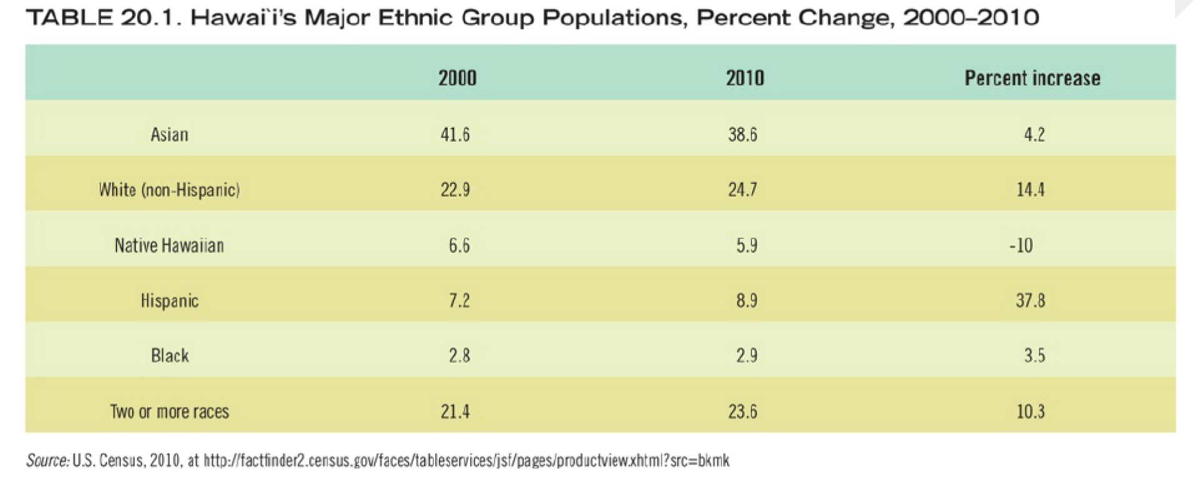

Slide 38
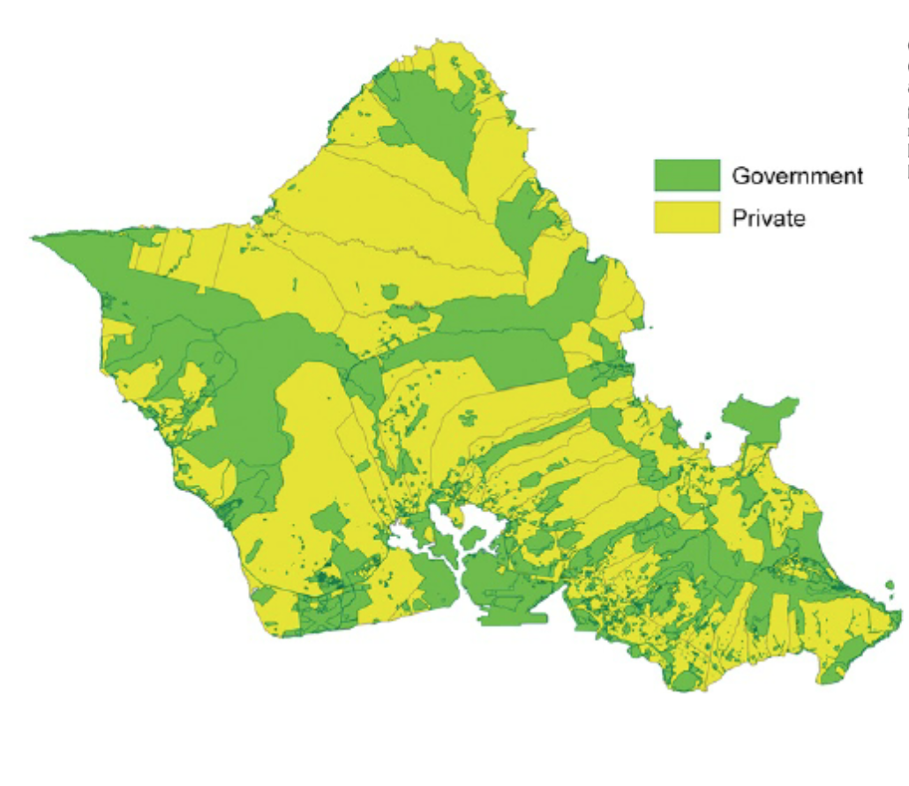
Homesteading
Hawaiian Homes Commission Act of 1920, aka the Homestead Act
There has been many controversies with the Homestead act because of racial discrimination and the 50% Hawaiian blood requirement
The Big Five: Land ownership owned by missionary families
Castle & Cooke
Alexander & Baldwin
C. Brewer
Amfac
Theo H. Davies and Co
Notes:
Congress first time addressing the native loss of land. It promised a 99 year homestead land lease for $1 annually to natives who had 50% Hawaiian blood.

Slide 39
economy

Slide 40
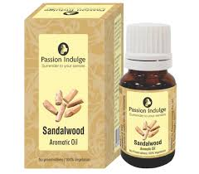
Original Economies
Sandalwood
Whaling
Ranching
Farming

Slide 41
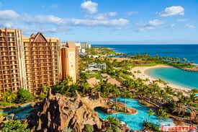
Tourism
Tourism mecca since the introduction of commercial airlines in the 1960s
Tourism accounts for over $10 billion of Hawaii’s economy and provided 32 percent of service jobs in 2004
Tourism aimed more towards wealthy travelers

Slide 42
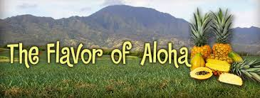
Exports
Sugar cane
Pineapples
Flowers
Bananas, Guava, other tropical fruit
Coffee
Macadamia Nuts

Slide 43
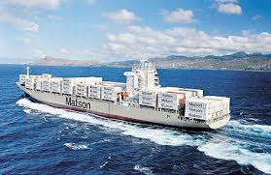
Imports
Food
Gasoline/Petroleum
Shipping problems
The islands’ isolation from other landmasses, their reliance on imported food, and dependence on tourism is unsustainable

Slide 44
Unintended consequences
And
Sustainability

Slide 45

Unintended Consequences
Urban and Agricultural runoff harm waters, marine life and coral reefs

Slide 46

Unintended Consequences
Frequent Beach Closures
Honolulu closed 52 day out of the year in 2005
Waikiki Beach closed for 42 days straight in 2006 due to sewage spill
In 2011 all beaches on leeward side closed twice

Slide 47
Sustainable Future
Sierra Club - Lost a lawsuit in 2000 against the Tourism Authority but the case highlighted problems facing Hawaii including limited resources and the strain of increasing tourism
Beach Environmental Awareness Campaign Hawai’i
organization working to educate the community about the impact that marine debris and waste has on the environment

Slide 48

Sustainable Future
Hawaii 2050 Sustainability Task Force Report
Highlights
-Population Growth
-Limited Land
-Rising Cost of Living
-Environmental Damage
-Energy Dependency
Outlines
-Goals
-Objectives
-Long Term plan

Slide 49

Journal Article
Sunscreen and the coral Reef

Slide 50


Toxicopathological effects of sunscreen
Oxybenzone(Benzophenone-3)
Environmental Contamination in Hawaii and the U.S. Virgin Islands
Oxybenzone is a photo-toxicant:adverse effects are exacerbated in the light.
Bleaches the coral reefs

Slide 51


Slide 52
Why are the Coral reefs important to our environment?
contains the most diverse ecosystems on the planet.
protect coastlines from the damaging effects of wave action and tropical storms
provide habitats and shelter for many marine organisms.
Sunscreen with Oxybenzone (benzophenone-3)
will be ban in Hawaii 2021

Slide 53

Reference page
Toxicopathological Effects of the Sunscreen UV Filter, Oxybenzone (Benzophenone-3), on Coral Planulae and Cultured Primary Cells and Its Environmental Contamination in Hawaii and the U.S. Virgin Islands
file:///C:/Users/Denise/Downloads/Downs2016_Article_ToxicopathologicalEffectsOfThe.pdf
The textbook: Mayda, Chris. The Regional Geography of The United States and Canada .Plymouth, UK: Rowman & Littlefield Publishers , 2013.
Website: Hawaii’s History https://www.travelonline.com/hawaii/history
Hawaiian History Britannica https://www.britannica.com/place/Hawaii-state
Countries and their Cultures https://www.everyculture.com/multi/Ha-La/Hawaiians.html
Kamilo Beach Image https://www.huffingtonpost.com/entry/kamilo-beach-hawaii-dirtiest-beach-america_us
Sustainable Future- HPOWER https://www.hawaiianelectric.com

